Slide 1


Research Methodology

Slide 2

Introduction:
Research in common parlance refers to a search for knowledge.
Research is also defined as a scientific and systematic search for pertinent information on a specific topic.
The purpose of research is to discover answers to questions through the application of scientific procedures.

Slide 3

What is research?
Careful or diligent search
Studious inquiry or examination; especially : investigation or experimentation aimed at the discovery and interpretation of facts, revision of accepted theories or laws in the light of new facts, or practical application of such new or revised theories or laws.
The collecting of information about a particular subject

Slide 4

Meaning of Research
According to Clifford Woody Research means
Defining and redefining problems, formulating hypothesis/objectives;
Collecting, organizing and evaluating data
Making deductions and reaching conclusions
Testing the conclusions to determine whether they fit the formulating hypothesis/objectives.

Slide 5

Objective of Research:
Each research study has its own specific purpose, we may think of research objectives as falling into a number of following broad groupings:
To gain familiarity with a phenomenon or to achieve new insights into it (studies with this object in view are termed as exploratory or formulative research studies)
To portray accurately the characteristics of a particular individual, situation or a group (studies with this object in view are known as descriptive research studies)

Slide 6

3. To determine the frequency with which something occurs or with which it is associated with something else (studies with this object in view are known as diagnostic research studies)
4. To test a hypothesis of a causal relationship between variables (such studies are known as hypothesis-testing research studies).

Slide 7

MOTIVATION IN RESEARCH
What makes people to undertake research? This is a question of fundamental importance. The possible motives for doing research may be either one or more of the following:
Desire to get a research degree along with its consequential benefits.
Desire to face the challenge in solving unsolved problems, i.e., concern over practical problems initiates research.
Desire to get the intellectual joy of doing some creative work.
Desire to be of service to society.
Desire to get respectability

Slide 8

TYPES OF RESEARCH The basic types of research are as follows:
Descriptive vs. Analytical:
Descriptive research includes surveys and fact-finding enquiries of different kinds. The major purpose of descriptive research is a description of the state of affairs as it exists at present. The main characteristic of this method is that the researcher has no control over the variables; he can only report what has happened or what is happening.
In analytical research, the researcher has to use facts or information already available and analyze these to make a critical evaluation of the material

Slide 9
Applied vs. Fundamental:
Research can either be applied (or action) research or fundamental (to basic or pure) research.
Applied research aims at finding a solution for an immediate problem facing a society or an industrial/business organization.
Fundamental research is mainly concerned with generalizations and with the formulation of a theory.

Slide 10
Quantitative vs. Qualitative:
Quantitative research is based on the measurement of quantity or amount. It is applicable to phenomena that can be expressed in terms of quantity.
Qualitative research, on the other hand, is concerned with qualitative phenomenon, i.e., phenomena relating to or involving quality or kind.

Slide 11
Conceptual vs. Empirical:
Conceptual research is related to some abstract idea(s) or theory. It is generally used by philosophers and thinkers to develop new concepts or to reinterpret existing ones.
Empirical research relies on experience or observation alone, often without due regard for system and theory. It is data-based research, coming up with conclusions that are capable of being verified by observation or experiment.

Slide 12
Other types of research
Longitudinal research:
If the research is based on either the purpose of research, or the time required to accomplish research, or on the environment in which research is done then such kind of research is called one-time research or longitudinal research.
Laboratory research: if research is carried on over several time periods then such research is named as laboratory research or simulation research.
Clinical or diagnostic research: if research follow case-study methods or in-depth approaches to reach the basic causal relations then its called clenical or diagnostic research.

Slide 13

Research Approaches
Mainly there are two basic approaches to research, the quantitative approach and the qualitative approach.
Qualitative approach:
This involves the generation of data in quantitative form which can be subjected to rigorous quantitative analysis in a formal and rigid fashion.
This approach can be further sub-classified into inferential, experimental and simulation approaches to research.
The purpose of the inferential approach is to form a database to conclude characteristics or relationships of the population. This usually means survey research where a sample of the population is studied to determine its characteristics, and it is then inferred that the population has the same characteristics.
Experimental approach is characterized by much greater control over the research environment and in this case some variables are manipulated to observe their effect on other variables.

Slide 14
The simulation approach involves the construction of an artificial environment within which relevant information and data can be generated. This permits observation of the dynamic behavior of a system (or its sub-system) under controlled conditions.
Qualitative approach:
This research approach is concerned with the subjective assessment of attitudes, opinions and behavior. Research in such a situation is a function of researcher’s insights and impressions. Such an approach to research generates results either in non-quantitative form or in the form which are not subjected to rigorous quantitative analysis. Generally, the techniques of focus group interviews, projective techniques and depth interviews are used.

Slide 15

Significance of Research
“All progress is born of inquiry. Doubt is often better than overconfidence, for it leads to inquiry, and inquiry leads to invention”- Hudson Maxim.
For educationists, in studying various educational problems and in seeking solutions to the various educational problems.
Fop social scientist, in studying social relationships and I seeking answers to the various social problems.
Provides the basis nearly for all government policies and our economic system.
For solving various operational and planning problems of business and industries.

Slide 16
Cont…
It inculcates scientific and inductive thinking.
It promotes the development of logical habits of thinking and organization.
To understand the new development in one’s field in better way.

Slide 17

Research methods vs Methodology
Research method: It may be understood as all those methods/techniques that are used for the conduction of research.
Research methods or techniques, thus, refer to the methods the researchers use in performing research operations.
Research Methodology: It is a way to systematically solve the research problem. It may be understood as a science of studying how research is done scientifically. In it we study the various steps that are generally adopted by a researcher in studying his research problem along with the logic behind them.

Slide 18
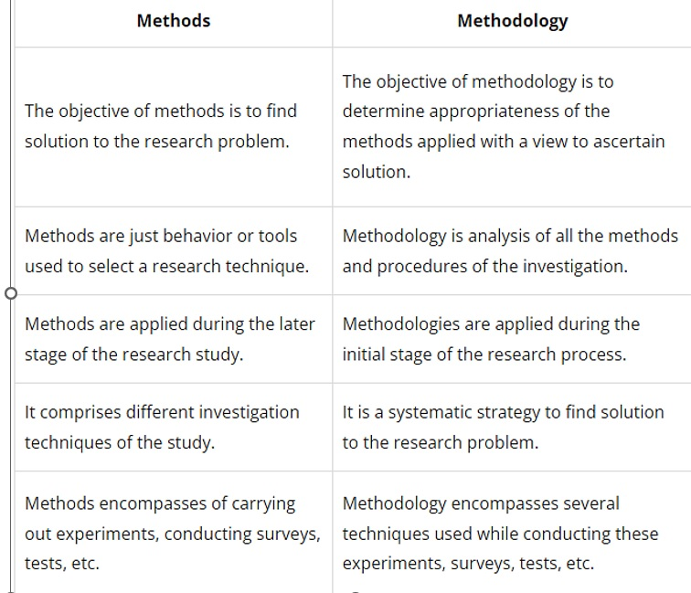

Slide 19

Scientific method of research
Scientific method is a systematic step-by-step procedure following the logical processes of reasoning.
Used to gain the knowledge of the universe.
According to Karl Pearson “Scientific method is one and same in all branches”.
It refers to the procedure and mode of investigation.

Slide 20

Basics of the scientific method
Reliance on empirical evidence.
Use of relevant concepts.
Commitment to objectivity.
Ethical neutrality
Generalization
Verifiability
Logical reasoning process.

Slide 21
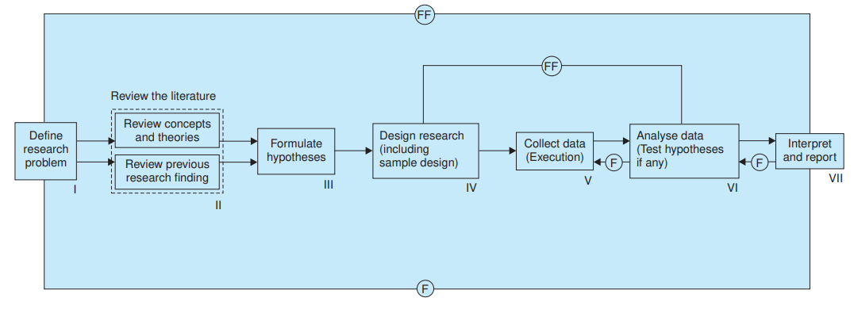
Research Process
Research process consists of series of actions or steps necessary to effectively carry out research and the desired sequencing of these steps. The chart shown in Figure below.
F- feed back
FF Feed forward

Slide 22

Research Problem
Research problem refers to some difficulty that a researcher experiences in the context of either a theoretical or practical solution and wants to obtain solutions for the same.
In a research process, research problem is the first and foremost step.
It can either be real-life situation or it may also refer to a set of opportunities.
There are two types of research problems:
Problem which relate to states of nature
Eg – Status of working children in any Metropolitan city in 2012
2. Problems that relate to relationships between variables.
Eg – Lack of chemical fertilizer in the main cause of low production of grain food.

Slide 23

Components of Research Problem
An individual or a group or an organization that has some difficulty or problem
Some objective to be attained
Alternative means for attaining the objectives
Some doubt in the mind of a researcher with regard to the selection of alternatives
Some environment(s) to which the difficulty pertains

Slide 24

Selecting Research Problem
Subject which is overdone shall not be chosen.
Controversial subject should not become the choice of an average researcher.
Too narrow or too vague problems should be avoided.
Subject selected for research should be familiar and feasible.
Few factors to be considered are importance of the subject, the costs involved, the time factor, the qualifications and the training of a researcher
Selection of a problem must be preceded by a preliminary study in case of new problems.

Slide 25

Necessity of defining research problem
To avoid deviating from the goal, the definition of a problem sets the direction of the study.
To derive the objective
Proper methodology and selection of study
Selection of variables of the study
Clarity for readers
Definition helps the researchers to control the subjectivity or biases of the researcher
Makes study feasible

Slide 26
Technique Involved In Defining A Problem
The techniques involved are:
Statement of the problem in a general way
Understanding the nature of the problem
Surveying the available literature
Developing ideas through discussions
Rephrasing the research problem into a working proposition.

Slide 27

Literature review
Drafting a strong literature review is considered the foundation of any research.
It helps to evaluate existing research and tells your teacher how your research is relevant to the respective field.
Moreover, it also discusses new insights that your research will contribute to the field of study.

Slide 28

What is a Literature Review?
A literature review is the research and evaluation of the available literature in your chosen topic area. It includes a survey of scholarly sources to provide an overview of the current research and available data and knowledge.
These sources include books, journal articles, and newspapers, that relate to your research question.
Moreover, it not only summarizes the sources. But it also analyzes, interprets, and evaluates the relevant theories, methods, points of view, and gaps in the existing literature.
However, this does not mean that a literature review is based on previous searches only. The writer discusses the research question and its various aspects and discusses the relevant study to support this claim.

Slide 29

Importance of a Good Literature Review?
Some of the key reasons to add a literature review into your research paper, thesis, and dissertation include:
It shows that the writer is familiar with the topic and the relevant literature.
It helps to develop a theoretical framework and methodology for the research.
It enables you to identify a research gap and contribute to filling that void by contributing to the field.
It resolves any conflicts between the previous studies.
Identify and highlight gaps and shortcomings in the existing body of knowledge and how things need to change.
Convey to readers how your study is different or how it contributes to the research area.

Slide 30

How long should a literature review be?
Ideally, the literature review should take up 15%-40% of the total length of your manuscript. So, if you have a 10,000-word research paper, the minimum word count could be 1500.
Your literature review format depends heavily on the kind of manuscript you are writing — an entire chapter in case of doctoral theses, a part of the introductory section in a research article, to a full-fledged review article that examines the previously published research on a topic.

Slide 31

Different types of literature reviews
All literature reviews are not the same. There are a variety of possible approaches that you can take. It all depends on the type of research you are pursuing.
Here are the different types of literature reviews:
1. Argumentative review:
It is called an argumentative review when you carefully present literature that only supports or counters a specific argument or premise to establish a viewpoint.

Slide 32
2. Methodological review:
This approach delves into the ''how'' and the ''what" of the research question, you cannot look at the outcome in isolation; you should also review the methodology used.
3. Systematic review:
This form consists of an overview of existing evidence pertinent to a clearly formulated research question, which uses pre-specified and standardized methods to identify and critically appraise relevant research and collect, report, and analyze data from the studies included in the review.

Slide 33
4. Meta-analysis review:
Meta-analysis uses statistical methods to summarize the results of independent studies. By combining information from all relevant studies, meta-analysis can provide more precise estimates of the effects than those derived from the individual studies included within a review.
5. Historical review:
Historical literature reviews focus on examining research throughout a period, often starting with the first time an issue, concept, theory, or phenomenon emerged in the literature, then tracing its evolution within the scholarship of a discipline. The purpose to place research in a historical context to show familiarity with state-of-the-art developments and identify future research's likely directions.

Slide 34

6. Scoping Review:
The Scoping Review is often used at the beginning of an article, dissertation, or research proposal. It is conducted before the research to highlight gaps in the existing body of knowledge and explains why the project should be greenlit.
7. State-of-the-Art Review:
The State-of-the-Art review is conducted periodically, focusing on the most recent research. It describes what is currently known, understood, or agreed upon regarding the research topic and highlights where there are still disagreements.

Slide 35

How to Write the literature review:
There are five key steps to writing a literature review:
Search for relevant literature
Evaluate sources
Identify themes, debates, and gaps
Outline the structure
Write your literature review

Slide 36

Step 1 – Search for relevant literature
Before you begin searching for literature, you need a clearly defined topic.
If you are writing the literature review section of a dissertation or research paper, you will search for literature related to your research problem and questions.
Make a list of keywords
Start by creating a list of keywords related to your research question. Include each of the key concepts or variables you’re interested in, and list any synonyms and related terms. You can add to this list as you discover new keywords in the process of your literature search.
Ex: self-esteem, mental health etc
Search for relevant sources
Use your keywords to begin searching for sources. Some useful databases to search for journals and articles include: Your university’s library catalog, Google Scholar, JSTOR, EBSCO etc

Slide 37

Step 2 – Evaluate and select sources
You likely won’t be able to read absolutely everything that has been written on your topic, so it will be necessary to evaluate which sources are most relevant to your research question.
For each publication, ask yourself:
What question or problem is the author addressing?
What are the key concepts and how are they defined?
What are the key theories, models, and methods?
Does the research use established frameworks or take an innovative approach?
What are the results and conclusions of the study?
How does the publication relate to other literature in the field? Does it confirm, add to, or challenge established knowledge?
What are the strengths and weaknesses of the research?

Slide 38

Make sure the sources you use are credible and make sure you read any landmark studies and major theories in your field of research.
You can use our template to summarize and evaluate sources you’re thinking about using. Click on either button below to download.
Take notes and cite your sources
As you read, you should also begin the writing process. Take notes that you can later incorporate into the text of your literature review.
It is important to keep track of your sources with citations to avoid plagiarism. It can be helpful to make an annotated bibliography, where you compile full citation information and write a paragraph of summary and analysis for each source.

Slide 39

Step 3 – Identify themes, debates, and gaps
To begin organizing your literature review’s argument and structure, be sure you understand the connections and relationships between the sources you’ve read. Based on your reading and notes, you can look for:
Trends and patterns (in theory, method or results): do certain approaches become more or less popular over time?
Themes: what questions or concepts recur across the literature?
Debates, conflicts and contradictions: where do sources disagree?
Pivotal publications: are there any influential theories or studies that changed the direction of the field?
Gaps: what is missing from the literature? Are there weaknesses that need to be addressed?
This step will help you work out the structure of your literature review and (if applicable) show how your own research will contribute to existing knowledge.

Slide 40

Step 4 – Outline your literature review’s structure
There are various approaches to organizing the body of a literature review. Depending on the length of your literature review, you can combine several of these strategies (for example, your overall structure might be thematic, but each theme is discussed chronologically).
Chronological:
The simplest approach is to trace the development of the topic over time. However, if you choose this strategy, be careful to avoid simply listing and summarizing sources in order.
Try to analyze patterns, turning points, and key debates that have shaped the direction of the field. Give your interpretation of how and why certain developments occurred.

Slide 41

Thematic
If you have found some recurring central themes, you can organize your literature review into subsections that address different aspects of the topic.
For example, if you are reviewing literature about inequalities in migrant health outcomes, key themes might include healthcare policy, language barriers, cultural attitudes, legal status, and economic access.
Methodological
If you draw your sources from different disciplines or fields that use a variety of research methods, you might want to compare the results and conclusions that emerge from different approaches.
For example:
Look at what results have emerged in qualitative versus quantitative research.
Discuss how the topic has been approached by empirical versus theoretical scholarship
Divide the literature into sociological, historical, and cultural sources.

Slide 42
Theoretical
A literature review is often the foundation for a theoretical framework. You can use it to discuss various theories, models, and definitions of key concepts.
You might argue for the relevance of a specific theoretical approach, or combine various theoretical concepts to create a framework for your research.

Slide 43

Step 5 – Write your literature review
Like any other academic text, your literature review should have an introduction, a main body, and a conclusion. What you include in each depends on the objective of your literature review.
Introduction
The introduction should clearly establish the focus and purpose of the literature review.
Body
Depending on the length of your literature review, you might want to divide the body into subsections. You can use a subheading for each theme, time period, or methodological approach.
As you write, you can follow these tips:
Summarize and synthesize: give an overview of the main points of each source and combine them into a coherent whole

Slide 44
Analyze and interpret: don’t just paraphrase other researchers add your own interpretations where possible, discussing the significance of findings in relation to the literature as a whole
Critically evaluate: mention the strengths and weaknesses of your sources
Write in well-structured paragraphs: use transition words and topic sentences to draw connections, comparisons and contrasts.
Conclusion
In the conclusion, you should summarize the key findings you have taken from the literature and emphasize their significance.
When you’ve finished writing and revising your literature review, don’t forget to proofread thoroughly before submitting.

